Slide 1
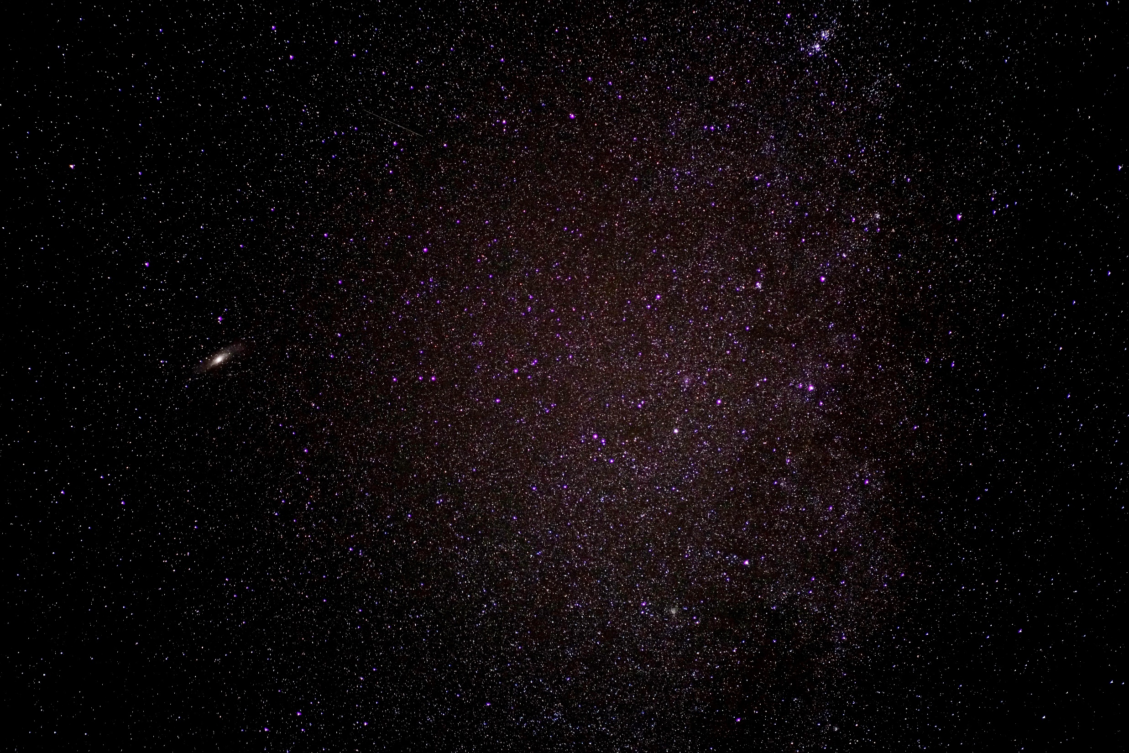
A SHORT SCI-FI
NARRATIVE STORY

Slide 2
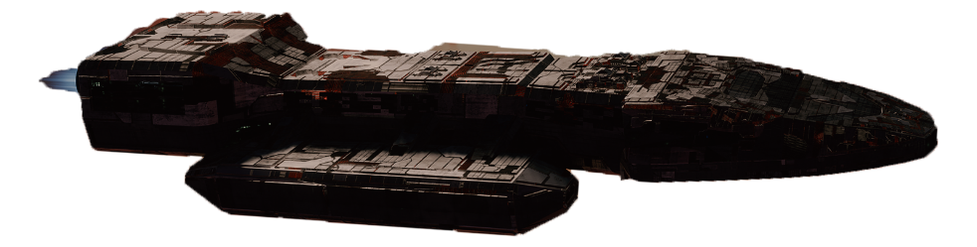
A lone astronaut travels aboard a research vessel,
far beyond familiar space.

Slide 3
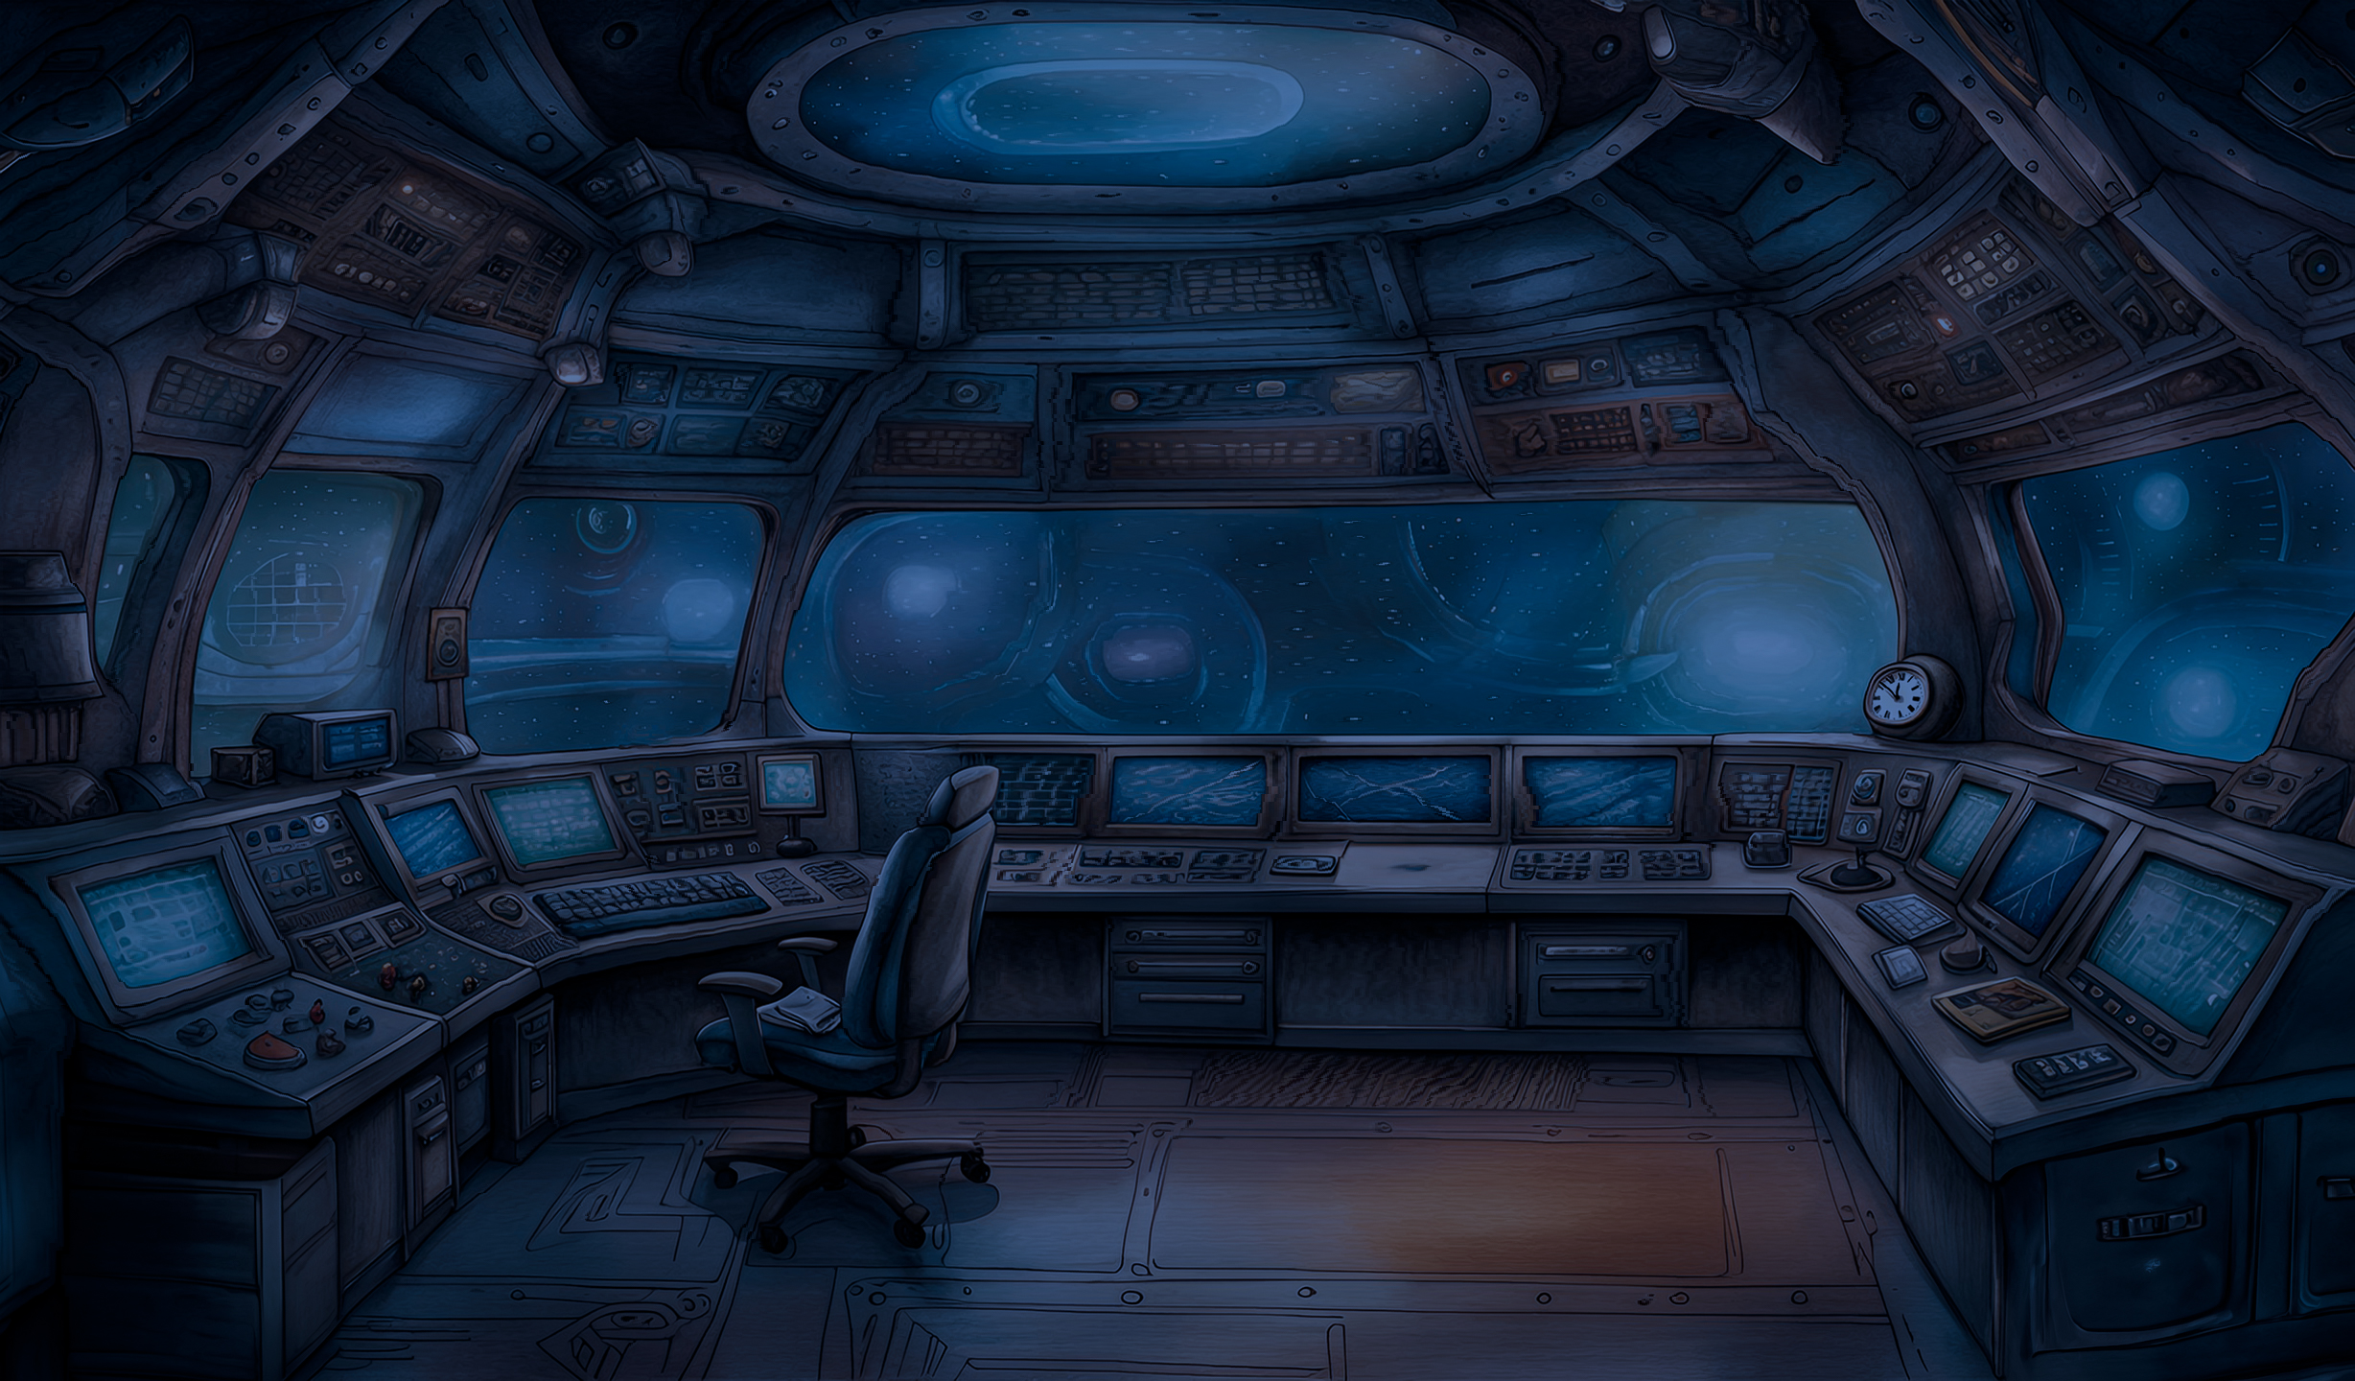
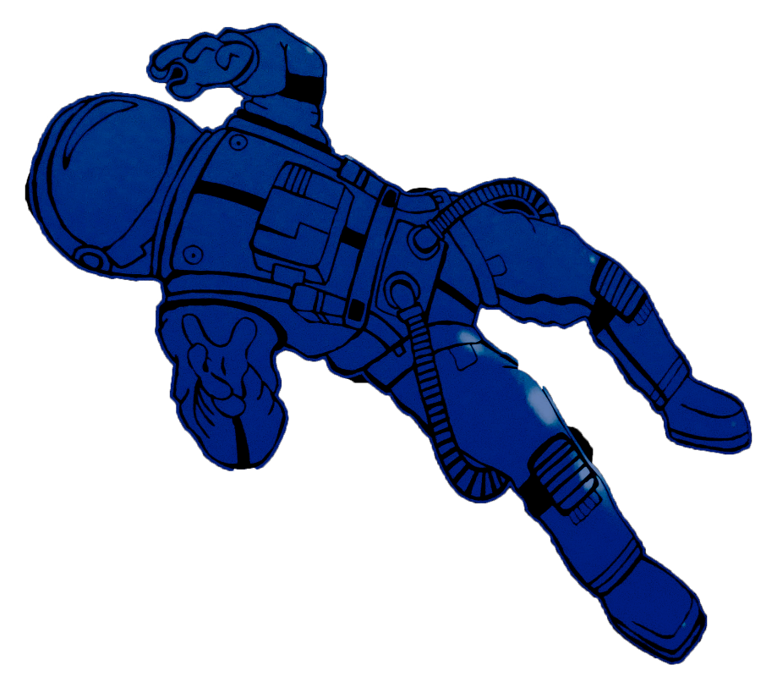
The mission is calm and routine,
until an unexpected moment changes everything.

Slide 4
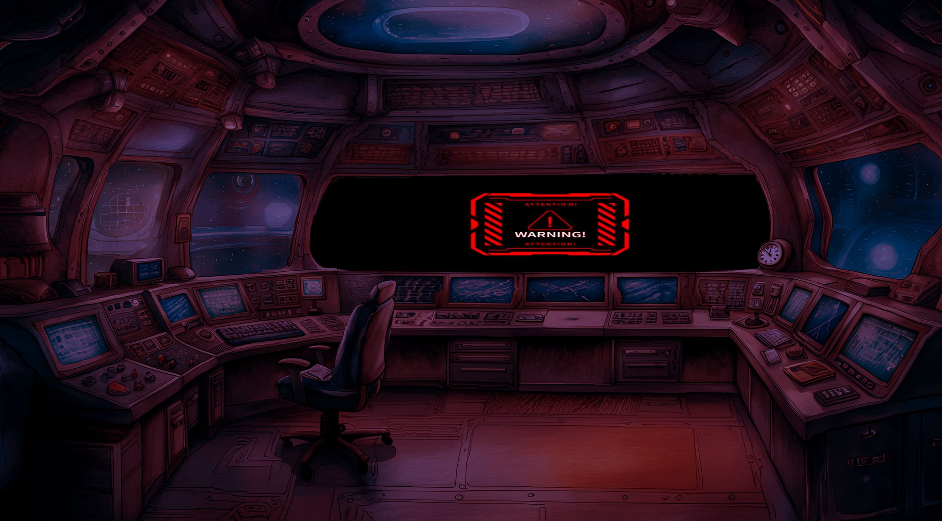
A sudden shock shakes the vessel. Lights flicker, alarms echo, and communication
systems collapse into static. The astronaut quickly realizes the mission is no longer under control.

Slide 5
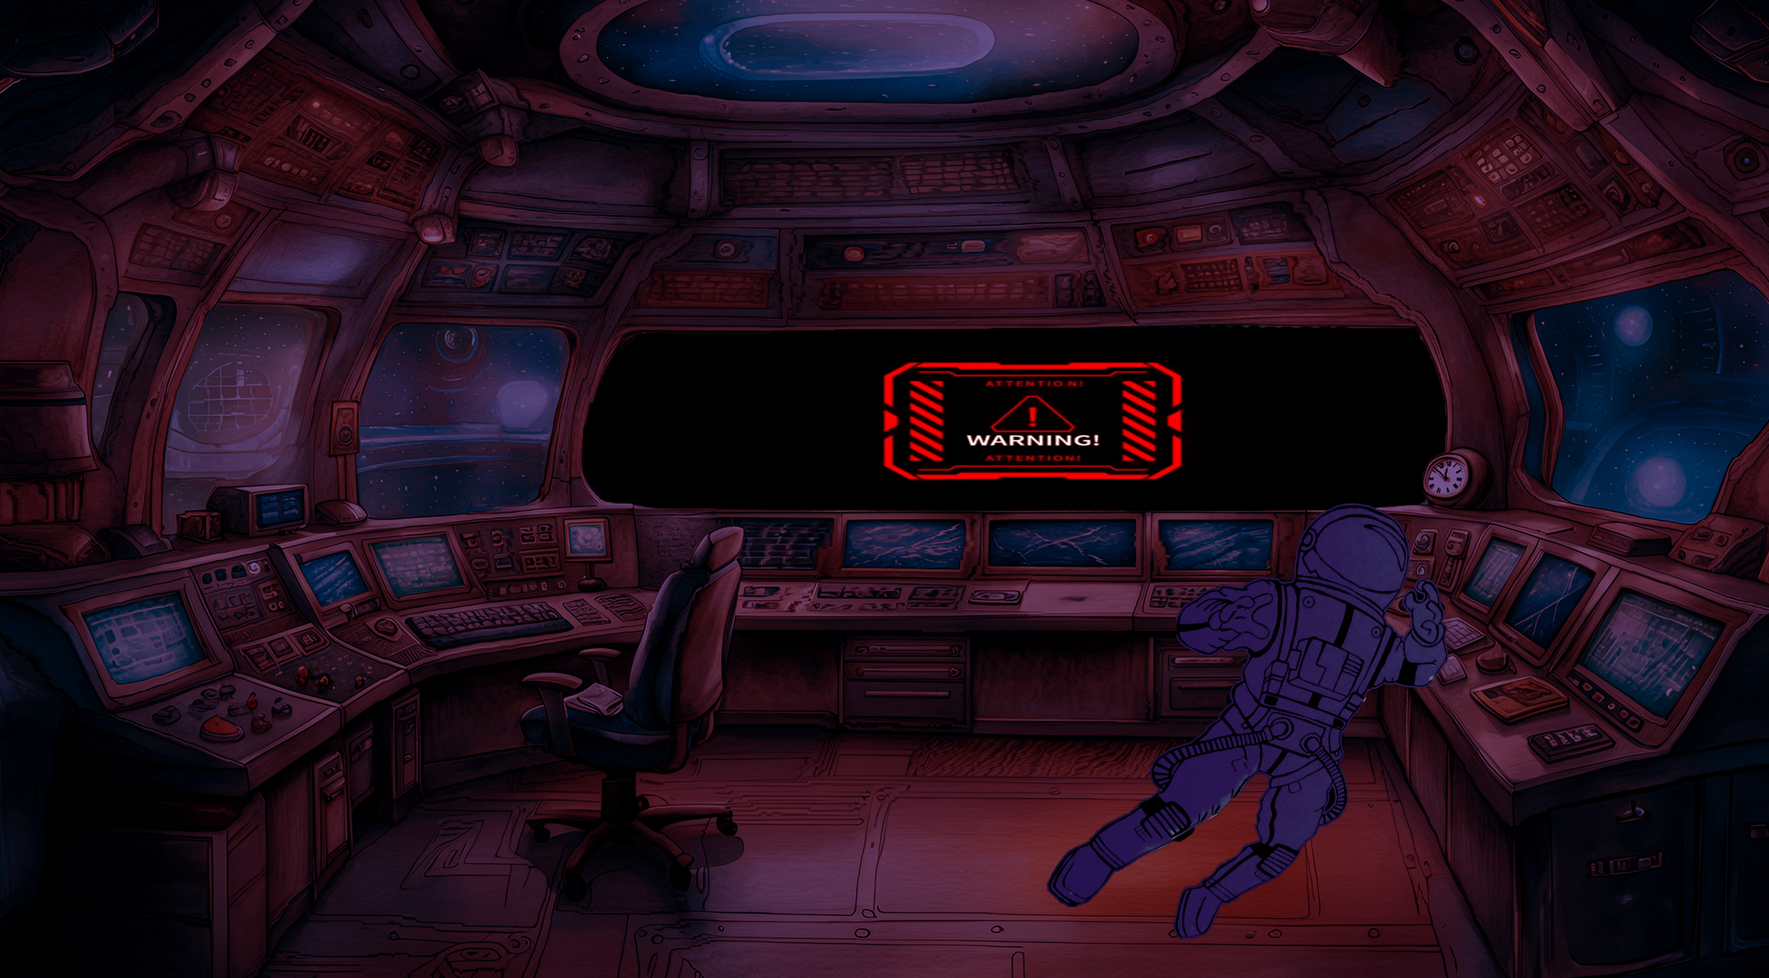
The astronaut inspects the damage. Panels hang open, tools float weightlessly, and sparks flicker like tiny stars. With limited power, repairs must begin immediately.

Slide 6
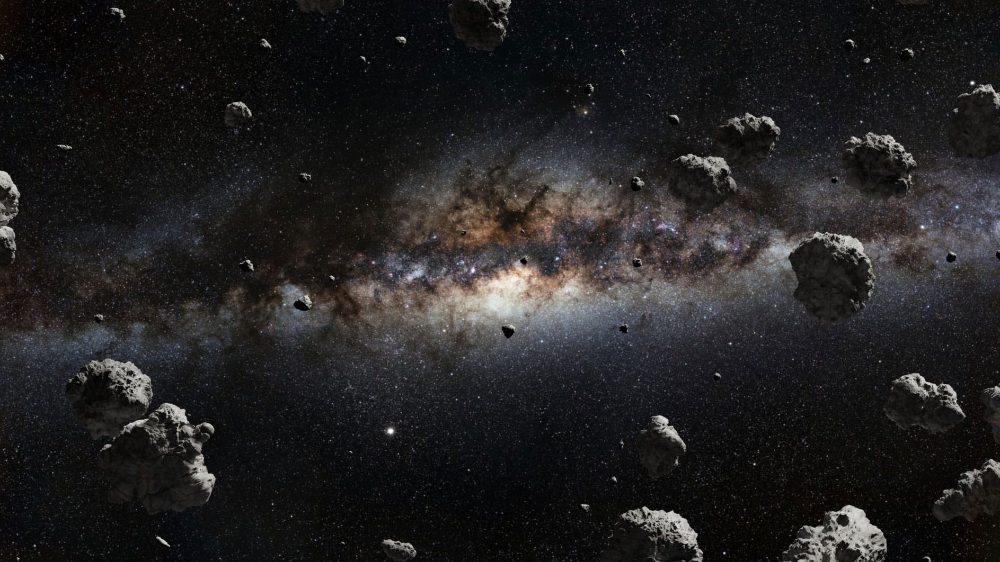
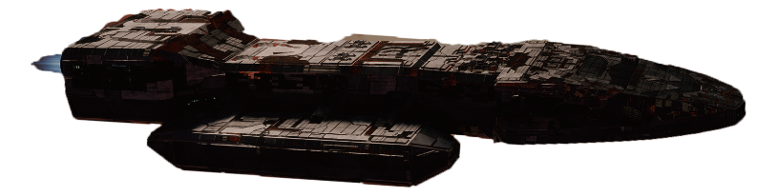
Time begins to work against the astronaut. Oxygen levels drop, backup systems fail, and debris strikes the hull from outside. The silence and isolation grow heavier with each minute.

Slide 7
Through the observation window, the endless ocean of stars stretches into the void. For a moment, the astronaut wonders if this is where the journey ends.

Slide 8
Refusing to surrender, the astronaut reroutes the last reserve of power.

Slide 9
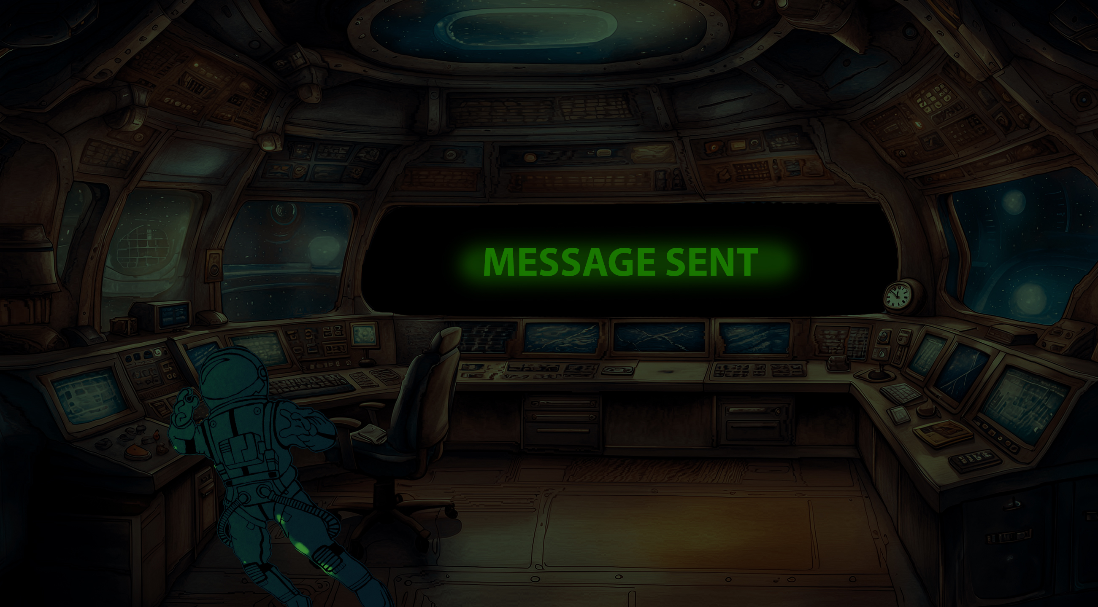
A damaged transmitter is brought back online,
and an emergency beacon is activated. It becomes the final hope for rescue.

Slide 10
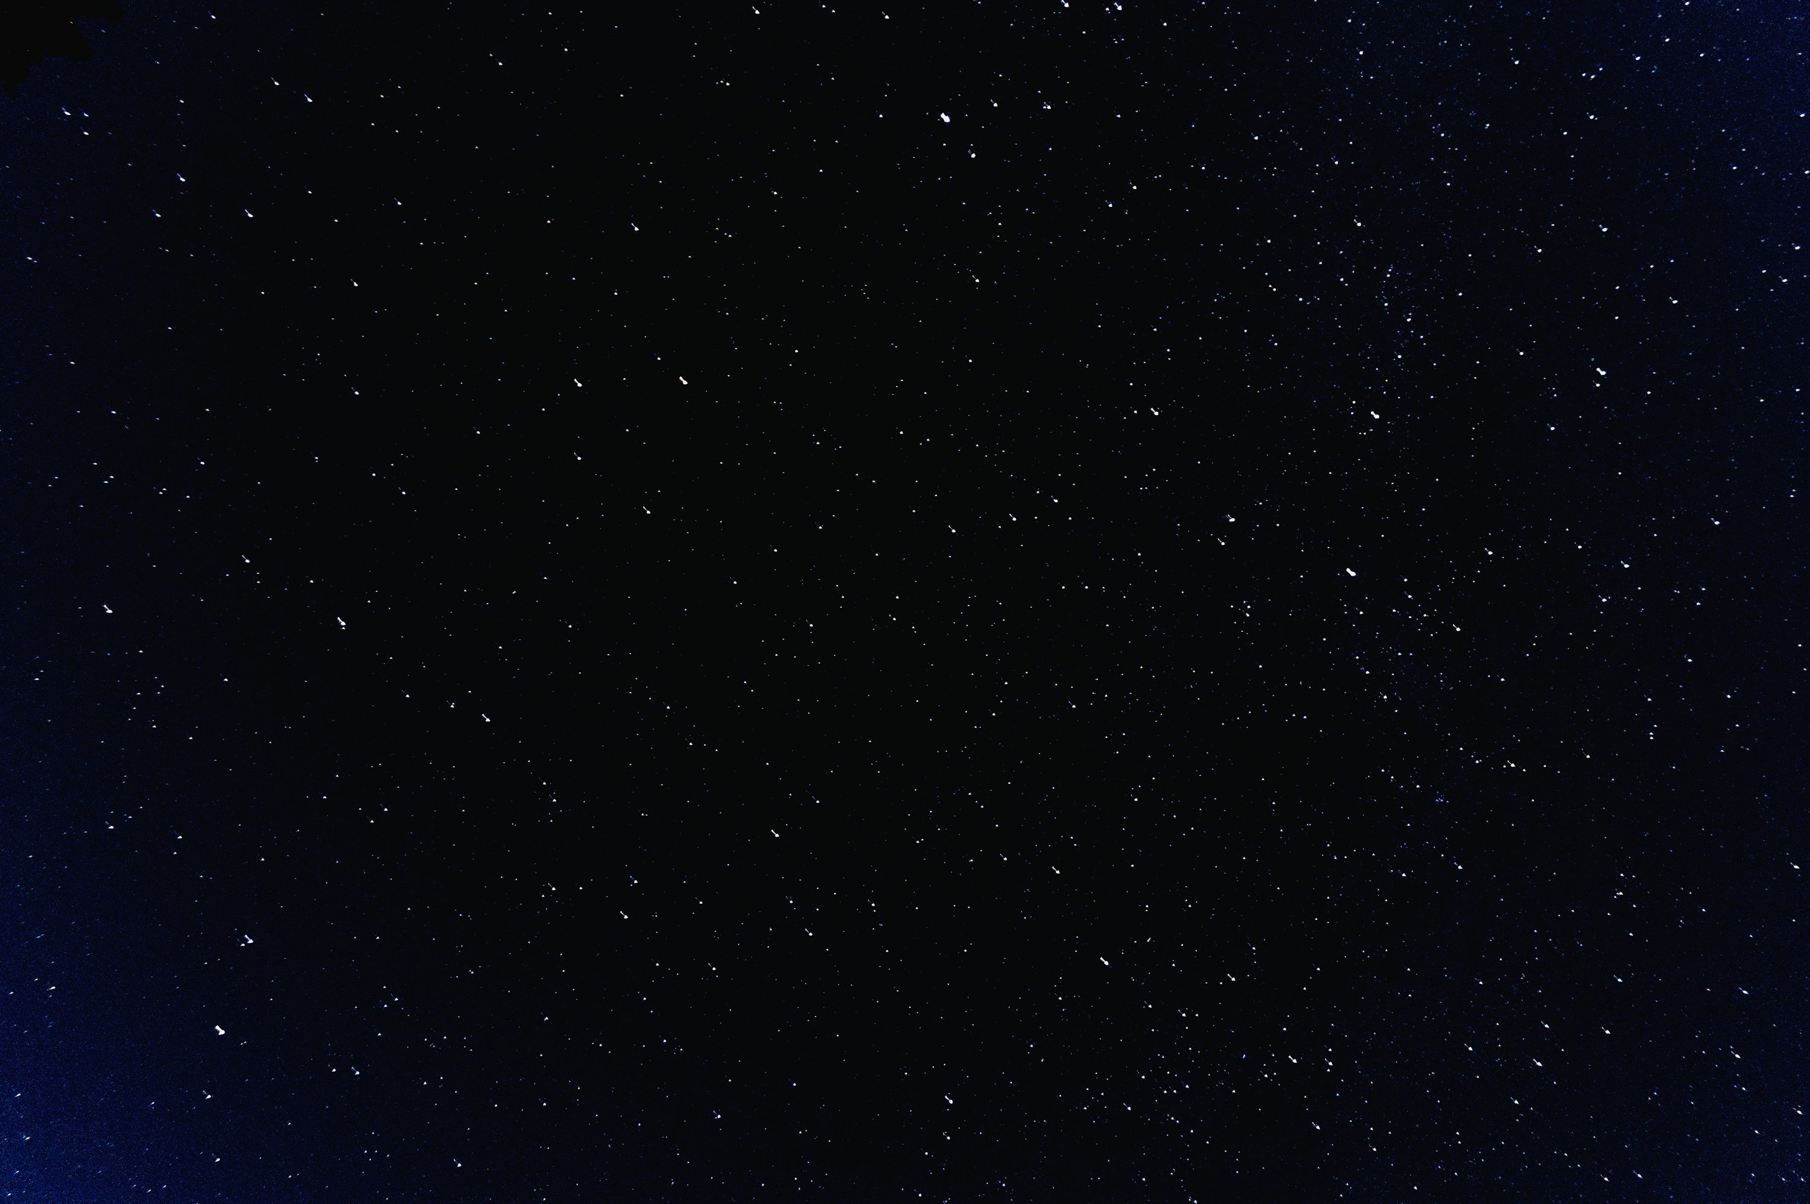
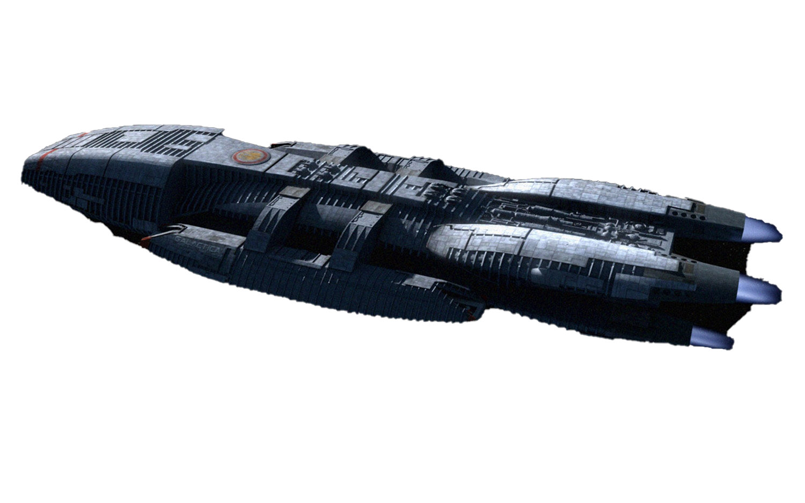
A rescue craft responds to the beacon. Hope returns as the vessel approaches, ending the isolation at last.

Slide 11
In the silence of space, it’s easy to feel small. But even there, hope can survive. Sometimes, all it takes is the choice to keep going.

